Slide 1
AI-Powered Research Assistant: Revolutionizing Research
A New Era of Research Efficiency and Innovation

Slide 2
Team Details
Team Name: The Researchers
Members:
Syed Muhammad Faiz -1602 - (TL)
Urooba Zaki – 1729
Muhammad Asif Khan -2541
Hafiz Jamil Asghar – 2891
Basharat Ali Butt -2199

Slide 3
Content
Problem Statement
Our Big Idea
Introduction
AI-Powered Research Assistant
Key Features
Benefits for Researchers and Scholars
How AI-Powered Research Assistant Works:
Visual Representation
Laptop View
Mobile View
Code Description
Benefits of AI-Powered Research Assistant
Final Result
Future Roadmap

Slide 4
Problem Statement
The challenges researchers face in today's information-rich world, such as:
Overwhelming amount of data
Time-consuming literature reviews
Difficulty finding relevant sources
Lack of insights and connections

Slide 5
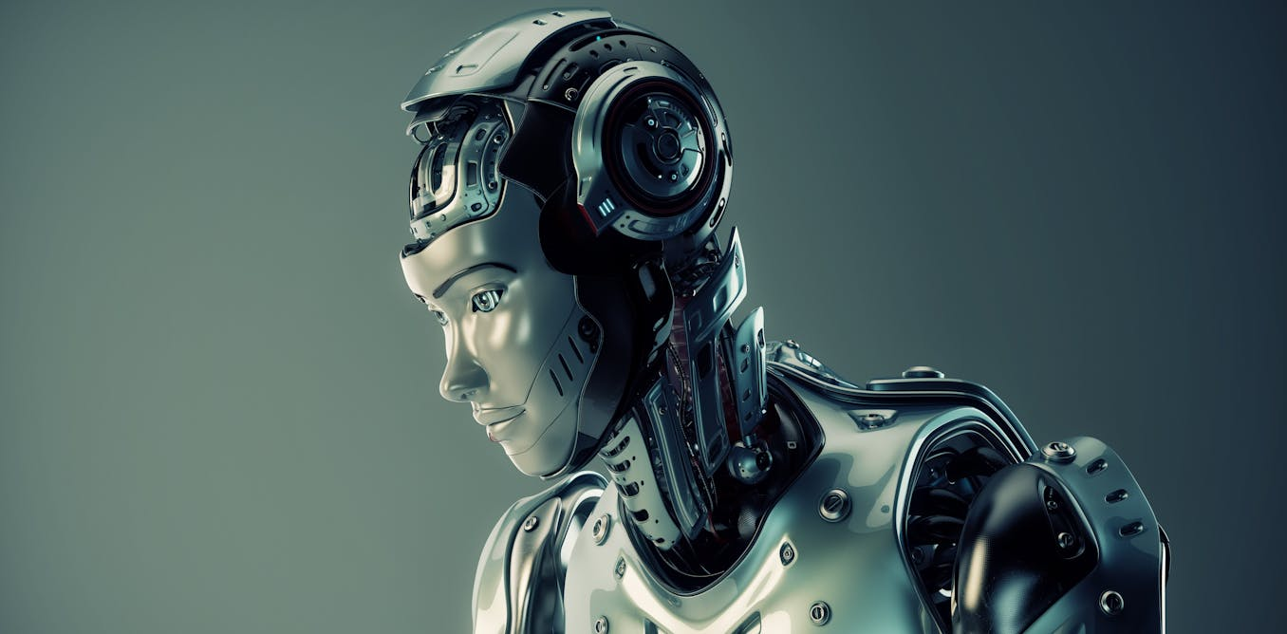
OUR BIG IDEA
Introduce the AI-powered research assistant as a solution to these problems.

Slide 6
Introduction
What is an AI-Powered Research Assistant?
Definition: Provide a clear and concise definition of an AI-powered research assistant.
AI-Powered Research Assistant designed to assist researchers in data gathering, analysis, writing, and many more.
How AI Helps:
Streamlining research processes
Providing deeper insights through data analysis
Enhancing productivity

Slide 7
Key Features
Literature Review Automation:
AI tools for quickly scanning, summarizing, and organizing literature.
Data Analysis:
Machine learning algorithms for complex data interpretation.
Citation Management:
Automatic referencing and citation suggestions.
Writing Assistance:
AI tools for drafting, editing, and enhancing research papers.

Slide 8
Benefits for Researchers and Scholars
Increased Efficiency: Highlight how the assistant can save time and effort for researchers.
Improved Accuracy: Discuss the potential for enhanced accuracy in research outcomes.
Enhanced Insights: Explain how the assistant can help researchers discover new connections and trends.
Facilitated Collaboration: Discuss how the assistant can support collaborative research efforts.

Slide 9
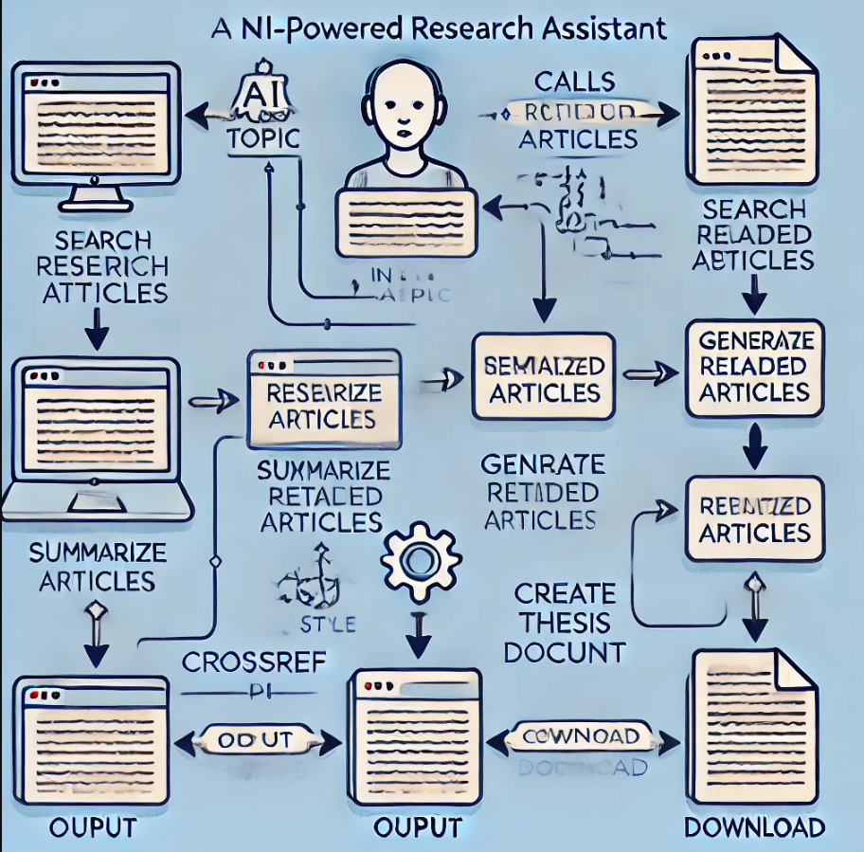
How AI Research Assistant, Works:
a flowchart diagram to illustrate the workflow of AI assistant.
Step-by-Step: Explain the process of how the assistant interacts with users, collects data, analyzes information, and provides insights.

Slide 10
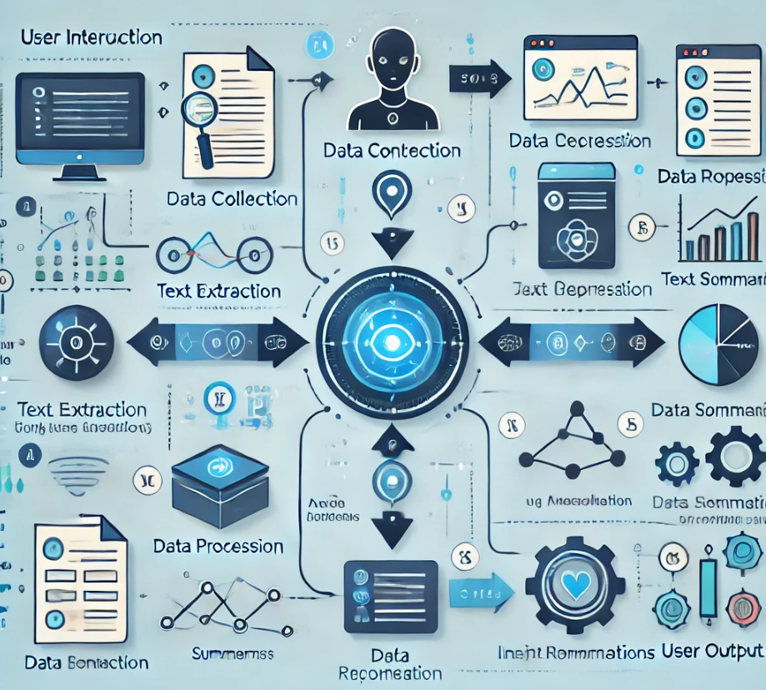
Another View, How it Works:

Slide 11
Step-By-Step Breakdown
User Input:
The user enters a research topic or question.
The assistant understands the query using natural language processing.
Article Search:
The assistant searches for relevant articles using databases like CrossRef.
Article Retrieval:
The assistant fetches the content of the selected articles.
Text Extraction:
The assistant extracts relevant text from the articles.
Summarization:
The assistant uses machine learning models to summarize the extracted text.
Citation Generation:
The assistant generates citations for the articles in the desired format.
Document Creation:
The assistant creates a formatted document (e.g., Word) containing the research topic, summaries, and citations.
Output:
The assistant provides the generated document to the user.

Slide 12
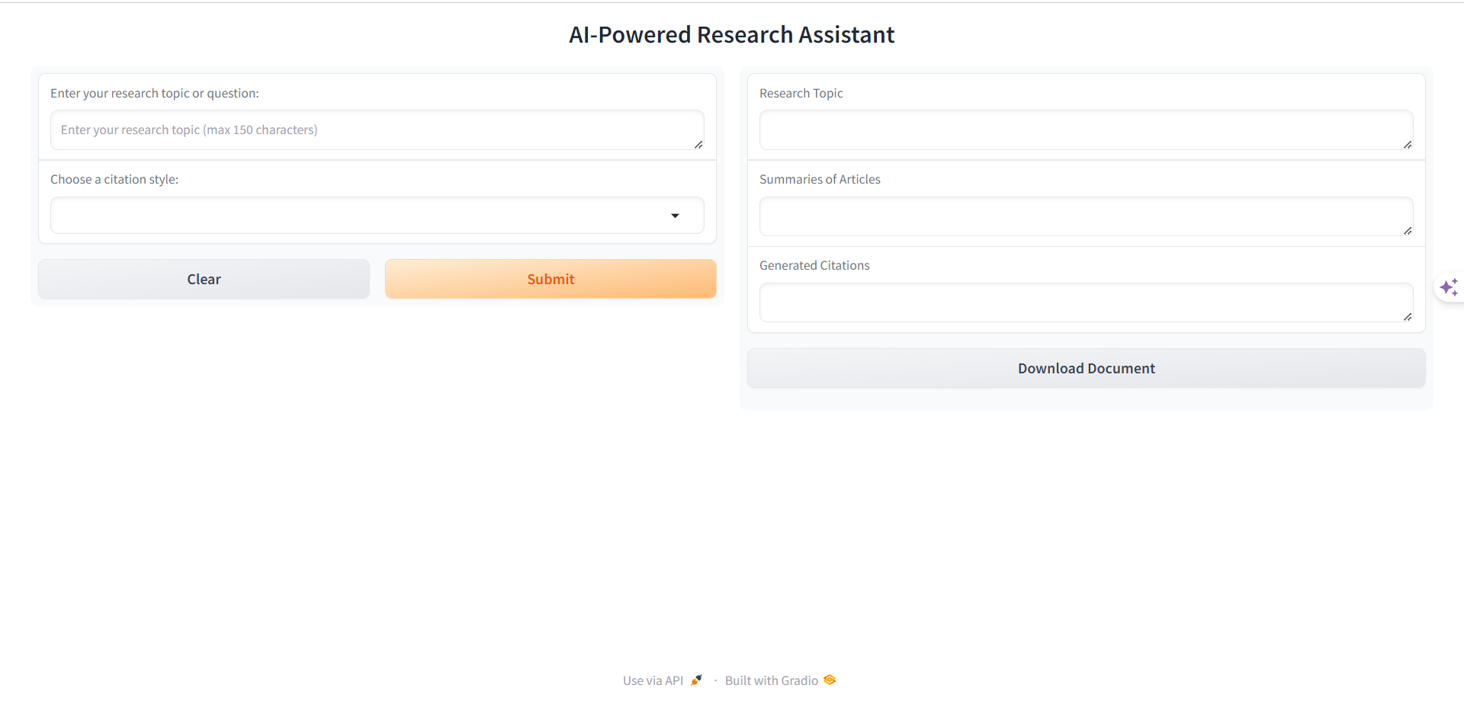
Visual Representation Laptop View

Slide 13
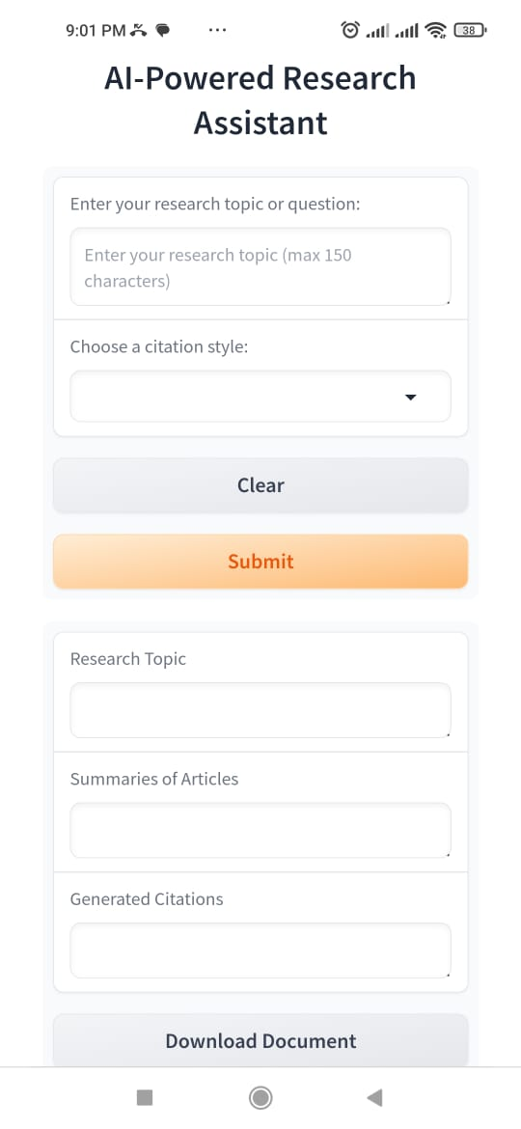
Visual Representation Mobile View

Slide 14
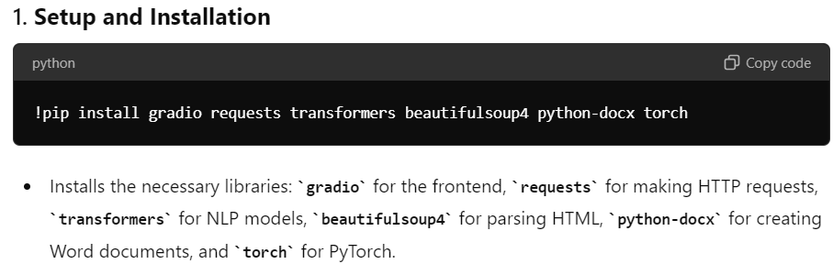
Code Description

Slide 15
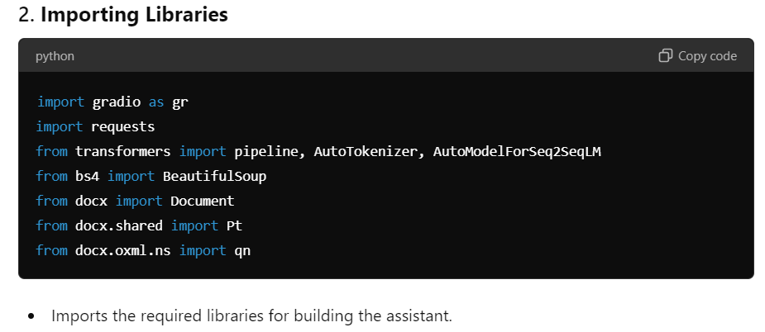

Slide 16
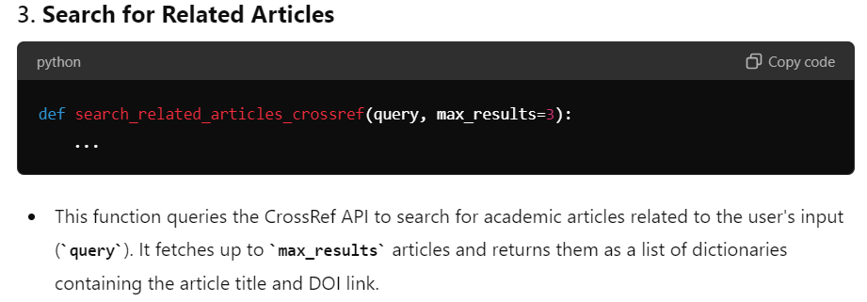

Slide 17
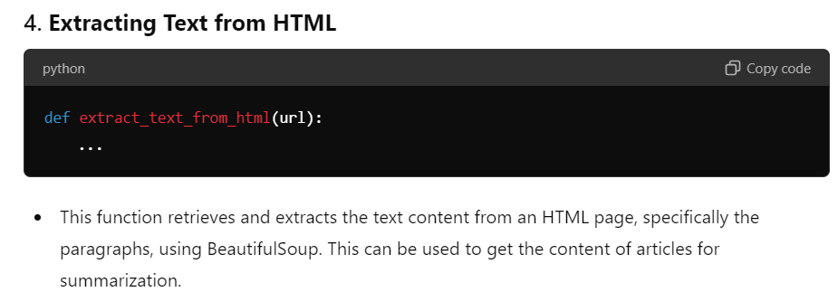

Slide 18
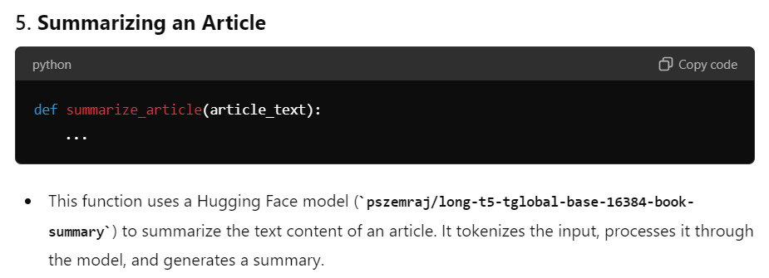

Slide 19
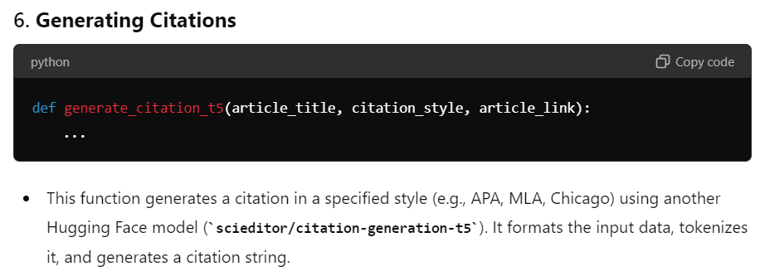

Slide 20
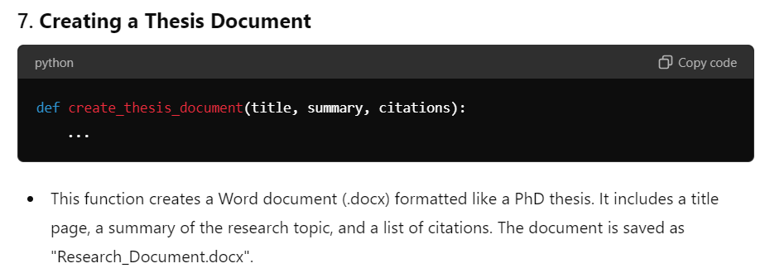

Slide 21
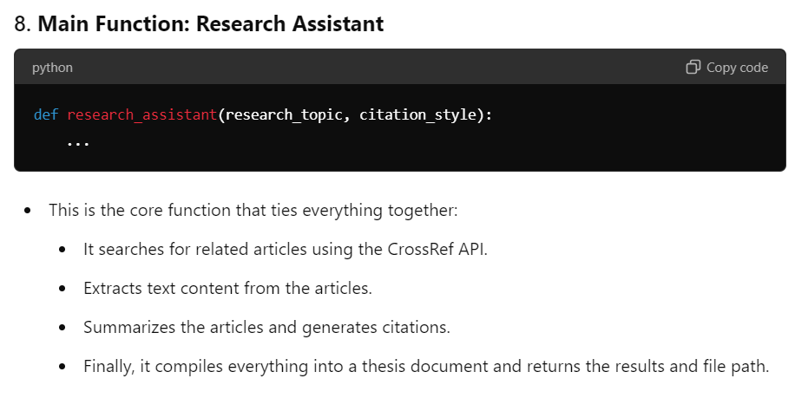

Slide 22
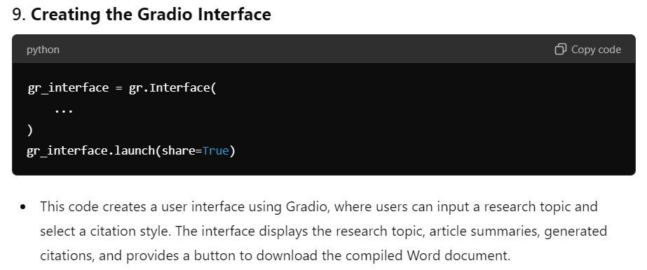

Slide 23


Slide 24
Benefits:
User Friendly
Run at Mobile, Laptops and PC, etc
Run at any Operating System
Generate a pdf or docx file
.

Slide 25
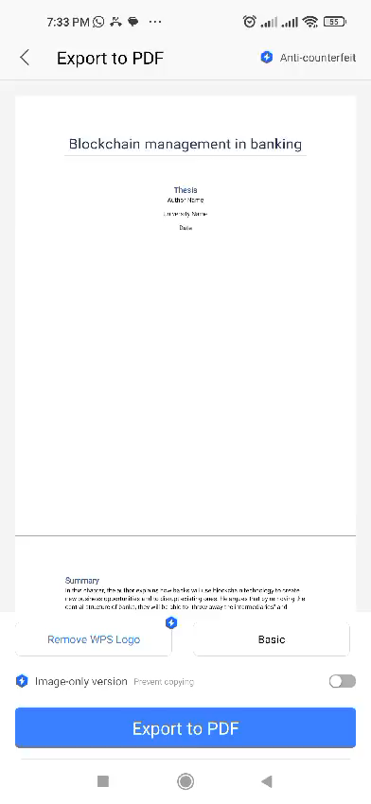
Results

Slide 26
Future Roadmap
Feature Expansion: Adding more NLP capabilities, like translation or topic modeling
Model Improvement: Ongoing training with new datasets
User Feedback: Iterative development based on user input

Slide 27
Thank
You

